Slide 1
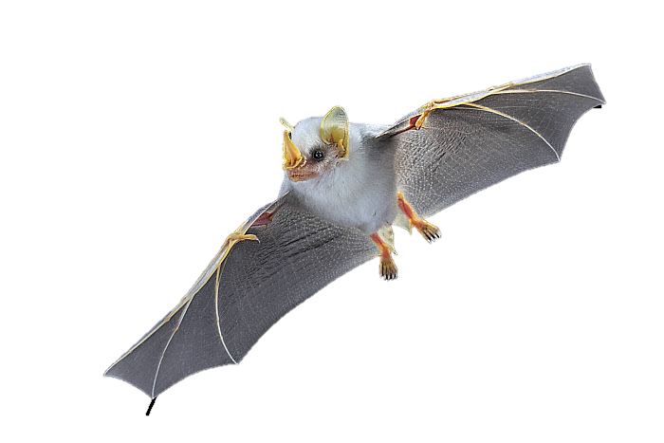
Mystery Animal
Without showing your partner this card or saying the name of the animal, describe your animal as precisely as you can. You cannot say that it is a bat.
Honduran White Bat
Mystery Animal
Person describing:
Person drawing:
Draw the animal here

Slide 2
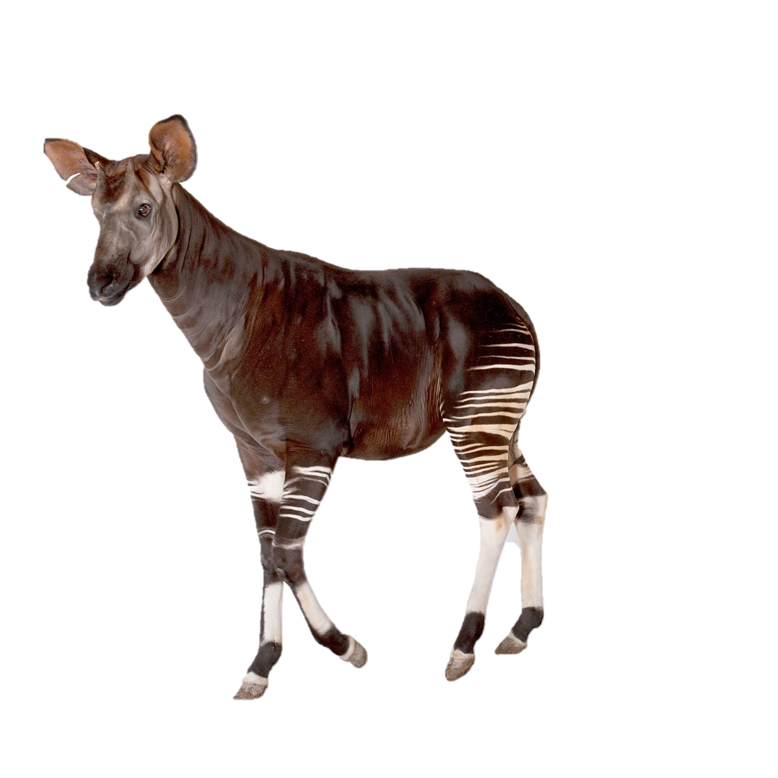
Mystery Animal
Without showing your partner this card or saying the name of the animal, describe your animal as precisely as you can. You cannot say that it looks like a horse or zebra.
Okapi
Mystery Animal
Person describing:
Person drawing:
Draw the animal here

Slide 3
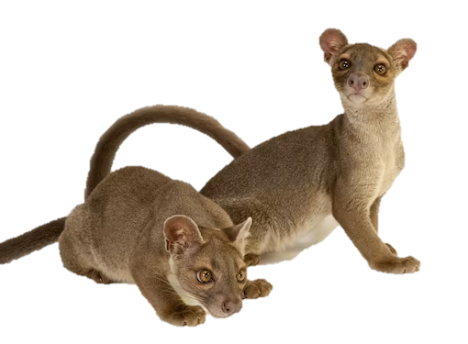
Mystery Animal
Without showing your partner this card or saying the name of the animal, describe your animal as precisely as you can. You cannot say that it looks like a cat.
Fossa
Mystery Animal
Person describing:
Person drawing:
Draw the animal here

Slide 4
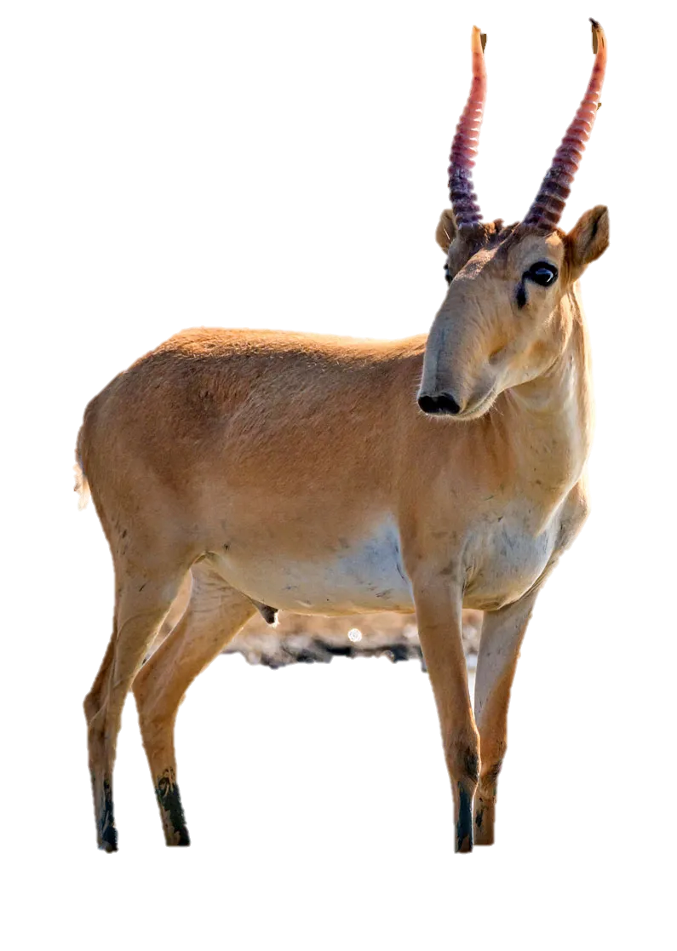
Mystery Animal
Without showing your partner this card or saying the name of the animal, describe your animal as precisely as you can. You cannot say that it looks like an antelope.
Saiga antelope
Mystery Animal
Person describing:
Person drawing:
Draw the animal here

Slide 5
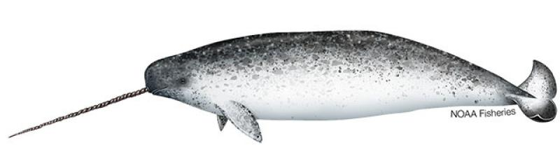
Mystery Animal
Without showing your partner this card or saying the name of the animal, describe your animal as precisely as you can. You cannot say that it looks like a dolphin, whale or unicorn.
Narwhal
Mystery Animal
Person describing:
Person drawing:
Draw the animal here

Slide 6
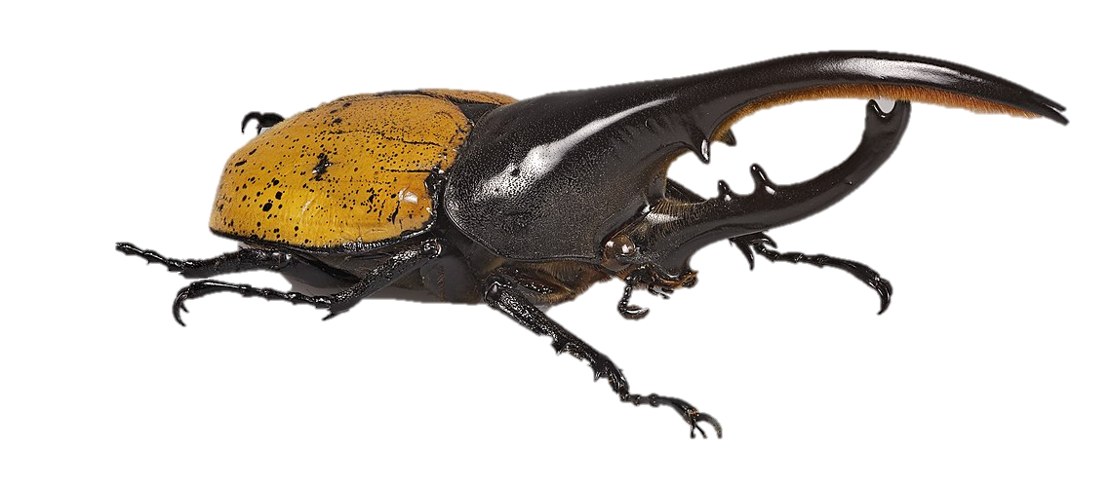
Mystery Animal
Without showing your partner this card or saying the name of the animal, describe your animal as precisely as you can. You cannot say that it is a beetle.
Hercules beetle
Mystery Animal
Person describing:
Person drawing:
Draw the animal here

Slide 7
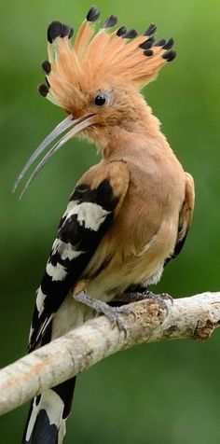
Mystery Animal
Without showing your partner this card or saying the name of the animal, describe your animal as precisely as you can. You cannot say that it is a bird.
Hoopoo
Mystery Animal
Person describing:
Person drawing:
Draw the animal here

Slide 8
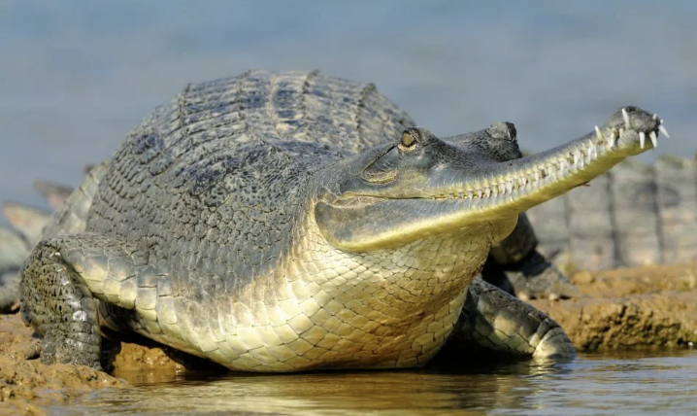
Mystery Animal
Without showing your partner this card or saying the name of the animal, describe your animal as precisely as you can. You cannot say that it looks like a crocodile or alligator.
Gharial
Mystery Animal
Person describing:
Person drawing:
Draw the animal here

